Slide 1
AI-Driven Hyper-Personalization System
AI-Powered Financial Recommendations
Team : Byte-ai
Ashish Sharma
Debasish Sahoo

Slide 2
Overview of the System
The system analyzes customer transactions, social media activity, and sentiment to provide personalized financial recommendations.
Uses Generative AI (GPT-3.5), Sentiment Analysis (VADER), and Intent Classification (BART-MNLI).
Built with FastAPI for API endpoints and Python for data processing & ML models.

Slide 3
Tech Stack
Programming Language: Python
Frameworks & Libraries: Pandas, NumPy, FastAPI, OpenAI API, Hugging Face Transformers
Machine Learning: Surprise (SVD), Implicit (Matrix Factorization)
Sentiment Analysis: VADER
Intent Classification: BART-Large-MNLI
Deployment: FastAPI + Uvicorn

Slide 4
Project Setup and Running the Application
Create a Conda Environment
conda create -n fastapi-env python=3.9 –y
Activate the environment:
conda activate fastapi-env
Install Dependencies
pip install -r requirements.txt
Set Up Environment Variables
OPENAI_API_KEY=your_openai_api_key_here
Run the Application
uvicorn app:app --reload
app.py:
The main application file containing the API endpoints and logic for the project.
requirements.txt:
Contains the list of Python dependencies required for the project. These are installed using pip install -r requirements.txt.
data:
A folder containing JSON files with customer profiles, transaction history, and social media posts used as input data for the application.
.env:
A file to store environment variables like OPENAI_API_KEY. This file is not included in version control for security reasons.

Slide 5
Loading and Preparing Data
JSON files store customer profiles, transaction history, and social media posts.
Data is converted into Pandas DataFrames for easy processing.
Ensures structured data format for further analysis.
with open("data/customer_profiles_filled_100.json", "r") as f:
customer_profiles = json.load(f)
customer_profiles_df = pd.DataFrame(customer_profiles)

Slide 6
Sentiment Analysis with VADER
Purpose: To determine customer sentiment from social media posts.
How it Works: VADER assigns a sentiment score ranging from -1 (negative) to +1 (positive).
Helps classify users as positive, negative, or neutral based on their emotions.
def get_sentiment(text):
return round(analyzer.polarity_scores(text)["compound"], 2)
social_media_df["sentiment_score"] = social_media_df["content"].apply(get_sentiment)

Slide 7
Intent Classification with BART-Large MNLI
Purpose: To classify social media content into predefined categories like Finance, Shopping, Tech, Budget Concern, etc.
How it Works: Zero-shot classification using facebook/bart-large-mnli model.
Enables understanding user interests for better recommendations.
def get_intent(text):
prediction = intent_classifier(text, intent_labels)
return prediction["labels"][0]
social_media_df["intent"] = social_media_df["content"].apply(get_intent)

Slide 8
Extracting Top Preferences
Identifies frequent transaction categories and social media interests per customer.
Extracts spending patterns to recommend relevant financial products.
def get_top_transaction_categories(customer_id, top_n=3):
user_transactions = transactions_df[transactions_df["customer_id"] == customer_id]
return ", ".join([cat for cat, _ in Counter(user_transactions["category"]).most_common(top_n)])

Slide 9
OpenAI GPT-3.5 API for Response Generation
Purpose: Generates business insights and financial product recommendations.
How it Works: Constructs a prompt using customer data and queries OpenAI API.
Automates tailored recommendations using AI-driven text generation.
def generate_response(prompt):
client = openai.OpenAI()
response = client.chat.completions.create(
model="gpt-3.5-turbo",
messages=[{"role": "user", "content": prompt}]
)
return response.choices[0].message.content

Slide 10
API Endpoints - Business Insights
/business_insights - Generates strategic financial insights based on transaction trends.
Provides business-level recommendations for financial institutions.
@app.get("/business_insights")
def generate_business_strategy():
top_purchases = transactions_df["category"].value_counts().nlargest(3).index.tolist()
avg_sentiment = social_media_df["sentiment_score"].mean()
sentiment_trend = "Positive" if avg_sentiment > 0.2 else "Negative" if avg_sentiment < -0.2 else "Neutral"
prompt = f"""
Analyze customer spending trends and sentiment to identify financial opportunities.
Top 3 Financial Services in Demand: {', '.join(top_purchases)}
Overall Customer Sentiment: {sentiment_trend}
"""
return {"strategy": generate_response(prompt)}

Slide 11
API Endpoints - Personalized Recommendation
/recommend/{customer_id} - Returns hyper-personalized product recommendations.
Provides tailored suggestions for credit cards, loans, and investment plans.
@app.get("/recommend/{customer_id}")
def generate_personalized_recommendation(customer_id: str):
customer = customer_profiles_df[customer_profiles_df["customer_id"] == customer_id].to_dict()
purchased_categories = transactions_df[transactions_df["customer_id"] == customer_id]["category"].value_counts().index.tolist()
sentiment_summary = social_media_df[social_media_df["customer_id"] == customer_id]["sentiment_score"].mean()
sentiment_trend = "Positive" if sentiment_summary > 0.2 else "Negative" if sentiment_summary < -0.2 else "Neutral"
top_intents = social_media_df[social_media_df["customer_id"] == customer_id]["intent"].value_counts().index.tolist()[:3]
prompt = f"""
Customer Profile: {customer}
Purchased Categories: {', '.join(purchased_categories) if purchased_categories else 'No past purchases'}
Overall Sentiment: {sentiment_trend}
Social Media Intents: {', '.join(top_intents) if top_intents else 'No social media data'}
Recommend hyper-personalized financial products.
""" return {"recommendation": generate_response(prompt)}

Slide 12
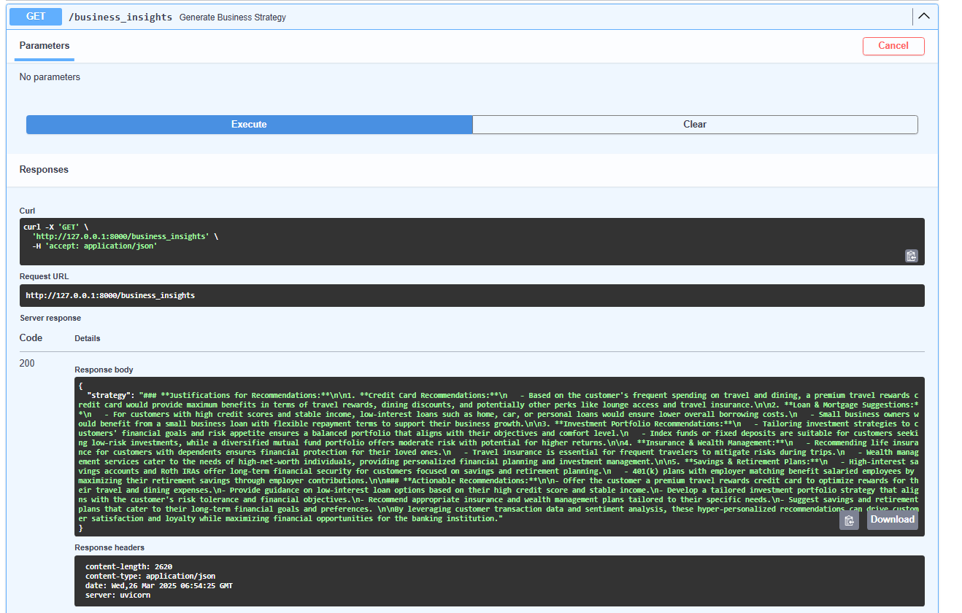
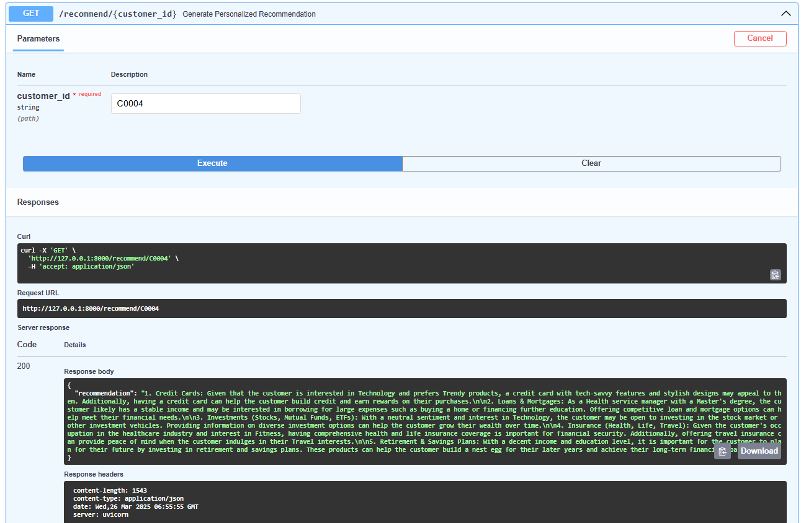
Swagger UI - http://127.0.0.1:8000/docs
Business Recommendations
Personalized Recommendation

Slide 13
Sample output: Business Recommendations
Sample output: Personalized Recommendation
Justifications for Recommendations:
Credit Card Recommendations: - Based on the customer's frequent spending on travel and dining, a premium travel rewards credit card would provide maximum benefits in terms of travel rewards, dining discounts, and potentially other perks like lounge access and travel insurance.-Loan & Mortgage Suggestions: - For customers with high credit scores and stable income, low-interest loans such as home, car, or personal loans would ensure lower overall borrowing costs. - Small business owners would benefit from a small business loan with flexible repayment terms to support their business growth.
Investment Portfolio Recommendations: - Tailoring investment strategies to customers' financial goals and risk appetite ensures a balanced portfolio that aligns with their objectives and comfort level. - Index funds or fixed deposits are suitable for customers seeking low-risk investments, while a diversified mutual fund portfolio offers moderate risk with potential for higher returns.
Insurance & Wealth Management: - Recommending life insurance for customers with dependents ensures financial protection for their loved ones. - Travel insurance is essential for frequent travelers to mitigate risks during trips. - Wealth management services cater to the needs of high-net-worth individuals, providing personalized financial planning and investment management.
Savings & Retirement Plans:- High-interest savings accounts and Roth IRAs offer long-term financial security for customers focused on savings and retirement planning. - 401(k) plans with employer matching benefit salaried employees by maximizing their retirement savings through employer contributions.
Actionable Recommendations:
Offer the customer a premium travel rewards credit card to optimize rewards for their travel and dining expenses.
Provide guidance on low-interest loan options based on their high credit score and stable income.
Develop a tailored investment portfolio strategy that aligns with the customer's risk tolerance and financial objectives.
Recommend appropriate insurance and wealth management plans tailored to their specific needs.
Suggest savings and retirement plans that cater to their long-term financial goals and preferences.
By leveraging customer transaction data and sentiment analysis, these hyper-personalized recommendations can drive customer satisfaction and loyalty while maximizing financial opportunities for the banking institution.
Credit Cards: Given that the customer is interested in Technology and prefers Trendy products, a credit card with tech-savvy features and stylish designs may appeal to them. Additionally, having a credit card can help the customer build credit and earn rewards on their purchases.
Loans & Mortgages: As a Health service manager with a Master's degree, the customer likely has a stable income and may be interested in borrowing for large expenses such as buying a home or financing further education. Offering competitive loan and mortgage options can help meet their financial needs.
Investments (Stocks, Mutual Funds, ETFs): With a neutral sentiment and interest in Technology, the customer may be open to investing in the stock market or other investment vehicles. Providing information on diverse investment options can help the customer grow their wealth over time.
Insurance (Health, Life, Travel): Given the customer's occupation in the healthcare industry and interest in Fitness, having comprehensive health and life insurance coverage is important for financial security. Additionally, offering travel insurance can provide peace of mind when the customer indulges in their Travel interests.
Retirement & Savings Plans: With a decent income and education level, it is important for the customer to plan for their future by investing in retirement and savings plans. These products can help the customer build a nest egg for their later years and achieve their long-term financial goals.

Slide 14
Business Impact
For Financial Institutions:
Improved customer engagement
Increased conversion on financial products
For Customers:
Personalized financial guidance
Better money management strategies

Slide 15
Future Improvements
Real-time AI-driven insights via live data streaming
Integration with banking APIs for deeper personalization
Advanced AI models (GPT-4, LLaMA, fine-tuned BERT)
Mobile app & chatbot for user accessibility

